Slide 1
Customer Data Management BMS Compliance Framework
June 2020

Slide 2
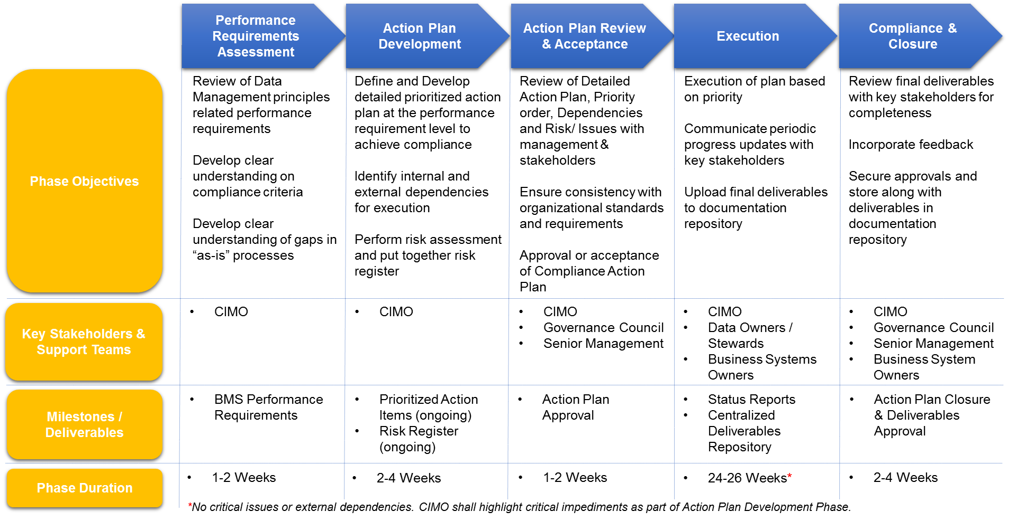
BMS Compliance Approach

Slide 3
Compliance Requirements Objectives
BMS Compliance
Requirements
Requirements
Category
Core Objectives
Identification of Key Data / Information
Identify key applications in support of Customer domain
Identification of Extracts from the applications
Data Elements level information identification
Identify Key Publications / Reports
Customer
6. & 7. Accessible & Published
1. Data is an Asset
2. Managed & Secured
3. Fit for Purpose
4. Standardized
5. Single Authoritative Source
Business Accountability & Context
Identify Data owners / Data Stewards
Identify key publications / reports owners
Lineage
Phased approach for lineage development
Application Level
Extract Level
Data Element Level
Authoritative Sources
Assess use of authoritative sources in key reports
Opportunities to use authoritative data sources identified and assessed
Use of authoritative sources implemented
Data Quality Issue Tracking
Basic data quality issue tracking
Quality issues attributed to key publications / reports
Implementation of enhanced data quality issue attribution, root cause analysis, and remediation
Data Quality Controls & Oversight
Ensure quality assessment and feedback loop in place with consumers of data
Opportunity to enhance existing controls identified

Slide 4
Data Management Dimensions

Slide 5
Data Management Dimensions – Integrated View

